Slide 1


Mobile Price Range Prediction
(Classification Project)
Capstone Project - 3
Contributed By:
Chetan Prakash
Kaushik Dey
Pallavi Wagh

Slide 2
Objective
To predict the price of mobile phones depending on the various factors related to the mobile phones.
And also to examine the accuracy of the outputs by implementing different Machine Learning models.

Slide 3
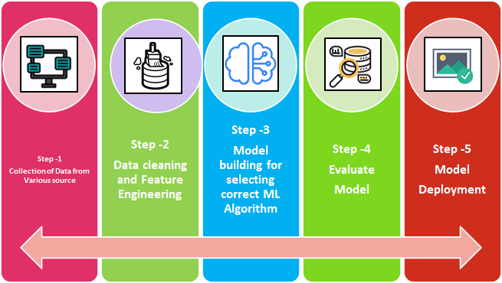
Steps included in the project:

Slide 4
Understanding the Dataset and Data Preprocessing:
Dataset Understanding
First Step of doing EDA is understanding the dataset.
Different Methods :
data.head()
data.shape()
data.info()
data.describe()
Dataset Preprocessing
It is a process of cleaning, transforming, preparing raw data into a suitable format for analysis.
Methods Involved:
len(data[data.duplicated])
data.isnull().sum
Data Wrangling
Data Encoding

Slide 5
Variable Description:
battery_power- Battery Capacity in MAh
blue- Has Bluetooth or not
clock_speed- Speed at which microprocessor executes instructions
dual_sim- Has dual sim support or not
fc- Front camera megapixels
four_g- Has 4g or not
int_memory- Internal memory capacity
m_dep- mobile depth in cm
mobile_wt- Weight of mobile phone
n_cores- Number of cores in processor
pc- Primary camera megapixels
px_height- Pixels resolution height
px_width- Pixel resolution width
ram- Random Access Memory in MB
sc_h- Screen Height
sc_w- Screen Width
talk_time- Longest that a single battery can last over a call
three_g- Has 3g or not
touch_screen- phone have touchscreen or keypad
wifi- Has wifi or not
price_range- This is the target variable with a value of 0 (low cost), 1 (medium cost), 2 (high cost), and 3 (very high cost)

Slide 6
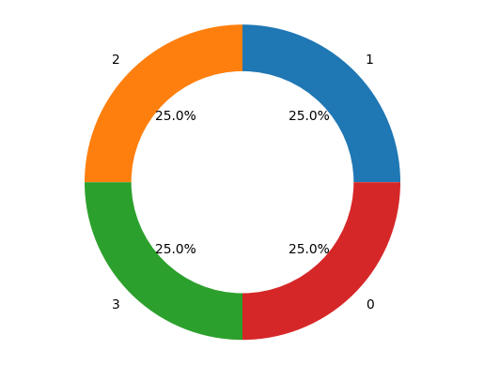
Quantity of mobile with price range:
Insights:
This charts shows that quantity of mobile according to price range percentage present in the dataset.
This chart give the information that all the price range mobile is popular in the market and people buy it.
.
Quantity of different Price Range Mobile

Slide 7
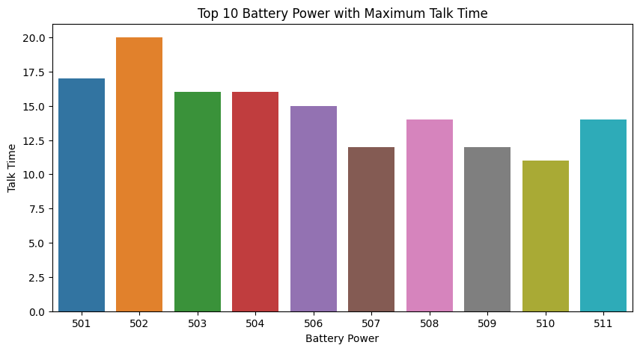
Talktime according to Battery power:
These are the TOP 10 Batteries power with maximum talktime. As we can see no particular pattern is shown in dataset talktime is basically depend on some more factor like customer uses.

Slide 8
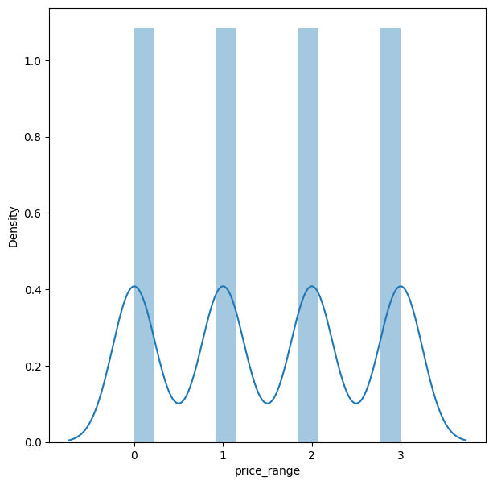
Distribution of target variable data:
The data are normally distributed.Hence we don’t need any transformation method like log10, square root and different other methods.

Slide 9
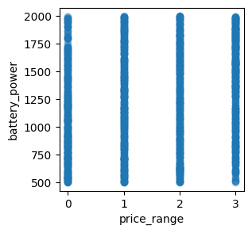
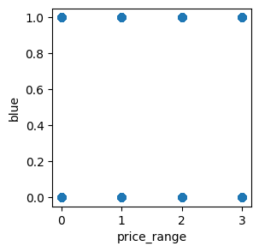
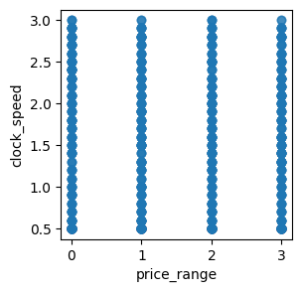
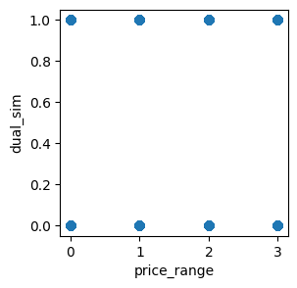
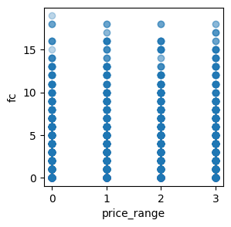
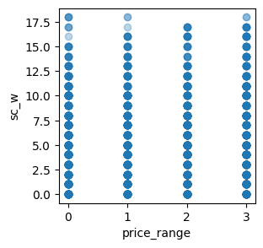
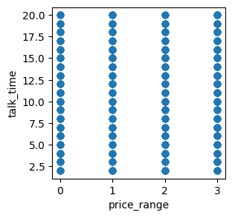
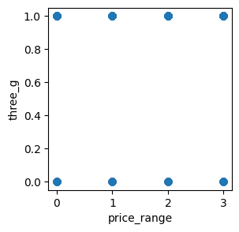
Relationship between independent variable to dependent variable:
Some features have direct relation like Battery power, Clock_speed etc. with target feature and some are not like Blue, sim ports etc.

Slide 10
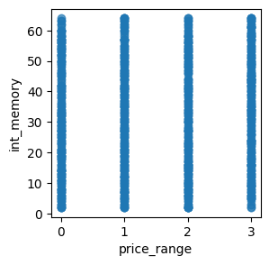

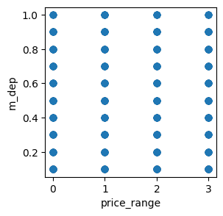
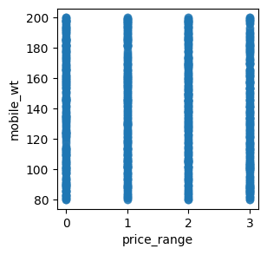
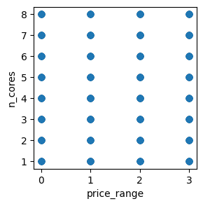
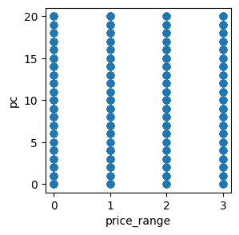
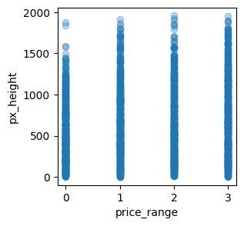
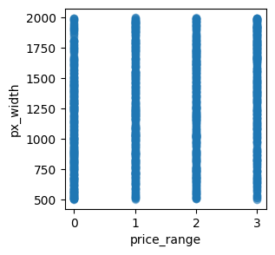
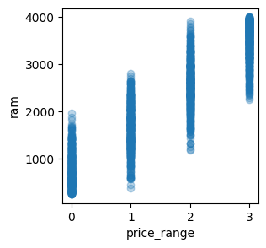
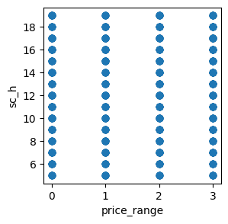
Continued…

Slide 11
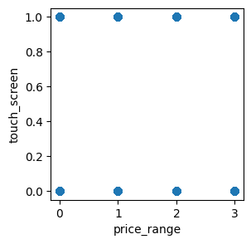
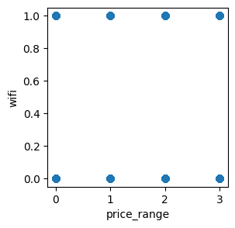
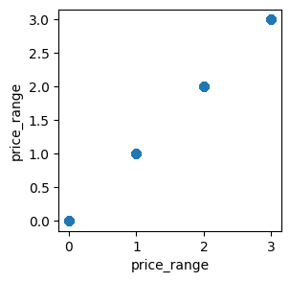
And some more charts.

Slide 12
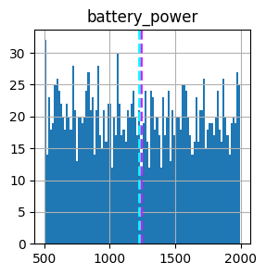
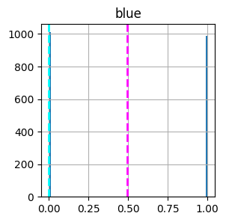
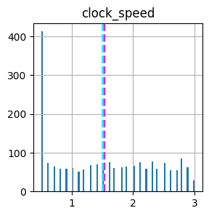
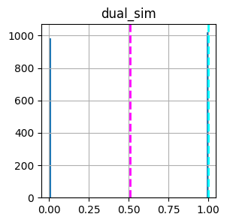
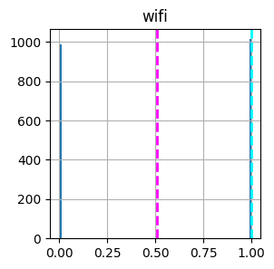
Charts to show the mean and median value of all numeric columns:
DOTTED CYAN LINE=MEDIAN
DOTTED MAGENTA LINE= MEAN
Median is the value in the middle of the category, the half quartile or middle value by which half values are up and half values are down.
Mean is the average of set of values of a category

Slide 13
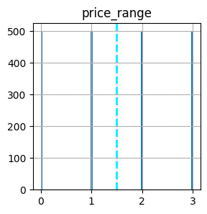
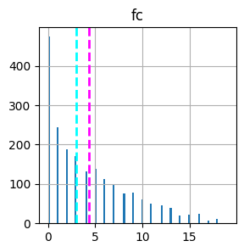
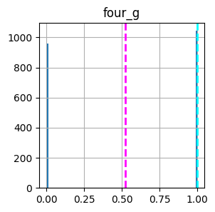
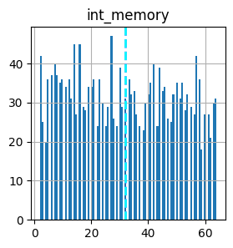
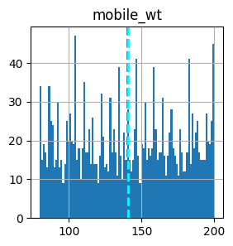
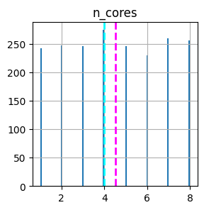
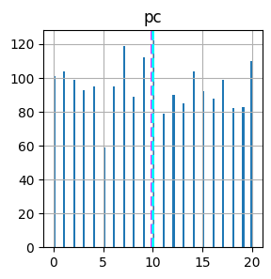
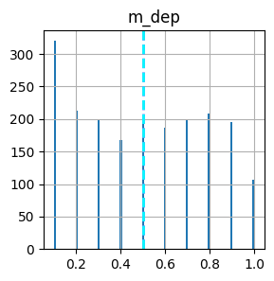
Continued…

Slide 14
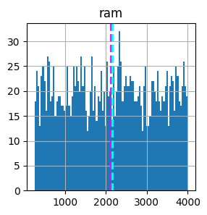
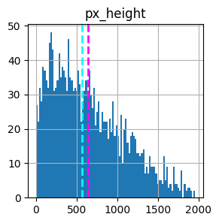
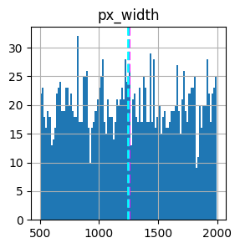
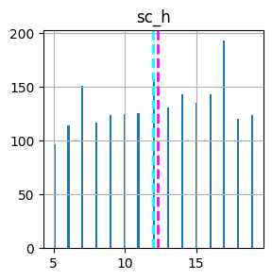
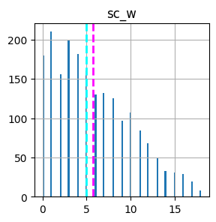
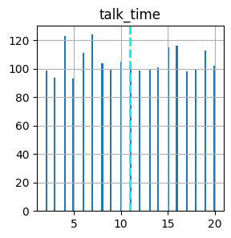
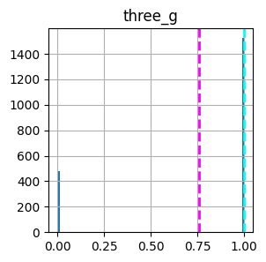
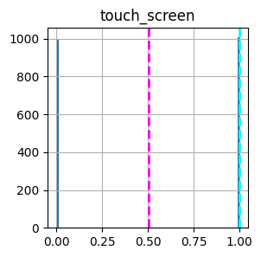
And some more charts.

Slide 15
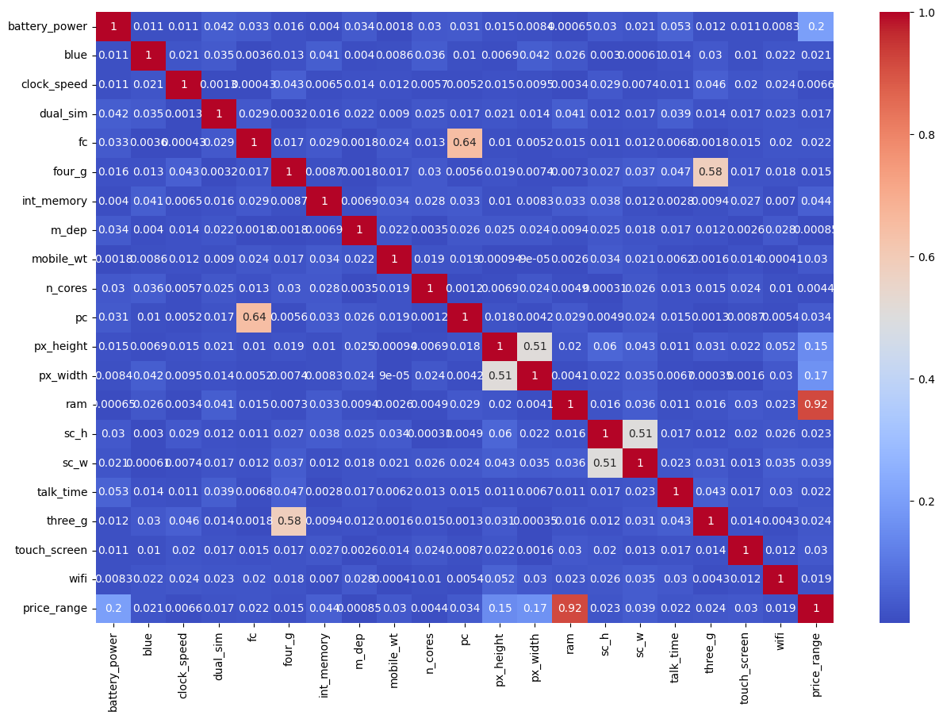
HEATMAP
Variable “pc” and “fc” is moderately correlated.
Variable “three_g” and “four_g” is moderately correlated
Variable “ram” and “price_rane” has the highest correlation.
“Px_width” and “px_height” has also very moderately correlated.

Slide 16



FEATURE Engineering and DATA Preprocessing
Feature engineering can help data scientists by accelerating the time it takes to extract variables from data, allowing for the extraction of more variables. We use to do this to reduce multicollinearity among the variables.
Feature Creation Front_Camera_Megapixel:
Feature Creation Ram and Price_Range:
Feature Creation Total_Pixel:
Feature Creation Screen_Size:

Slide 17
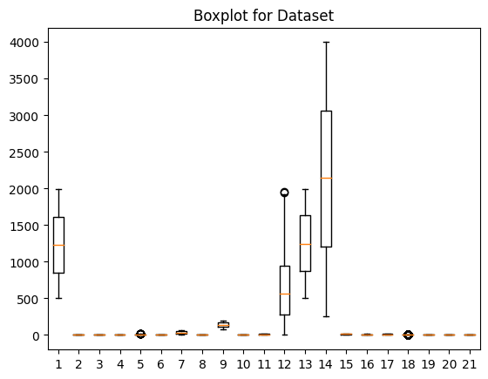
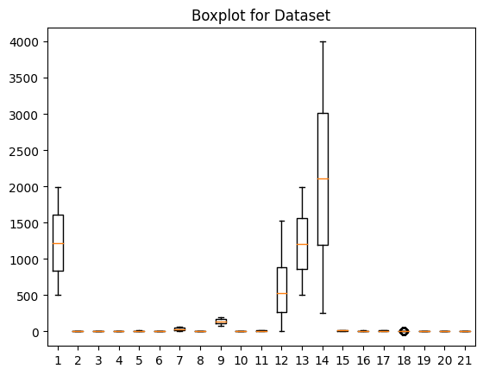
Handling Outliers
Outlier Detected at 12th column i.e. Pixel , so we treated the outlier with Z-Score.
Now the outlier has been treated. We took Z-score less than 2 here.

Slide 18
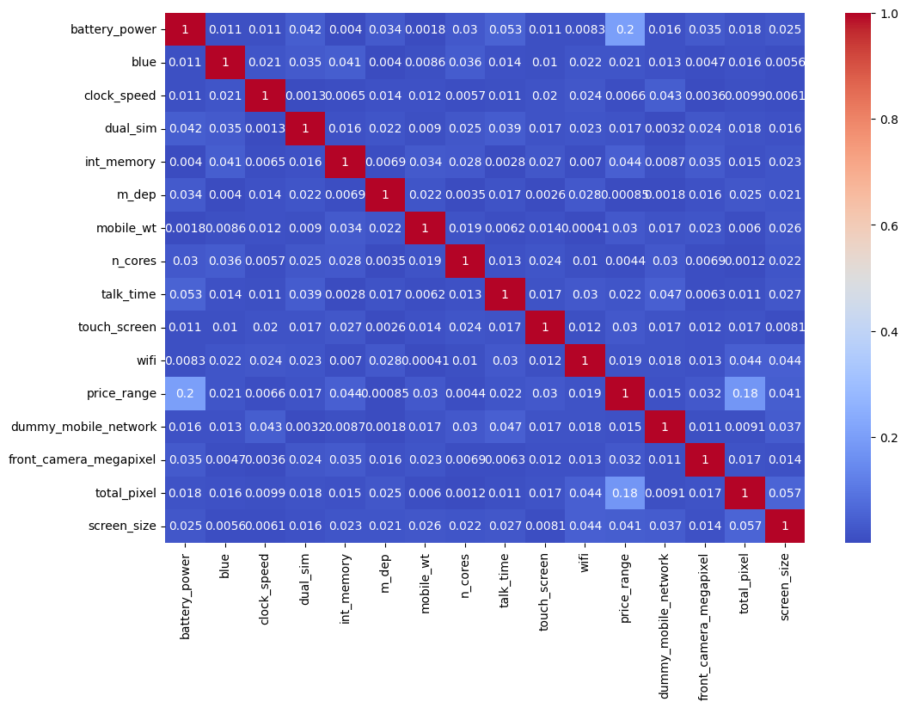
Checking the Correlation with New Variables
All the dependencies have been handled. We have resolved the multicollinearity problem.

Slide 19
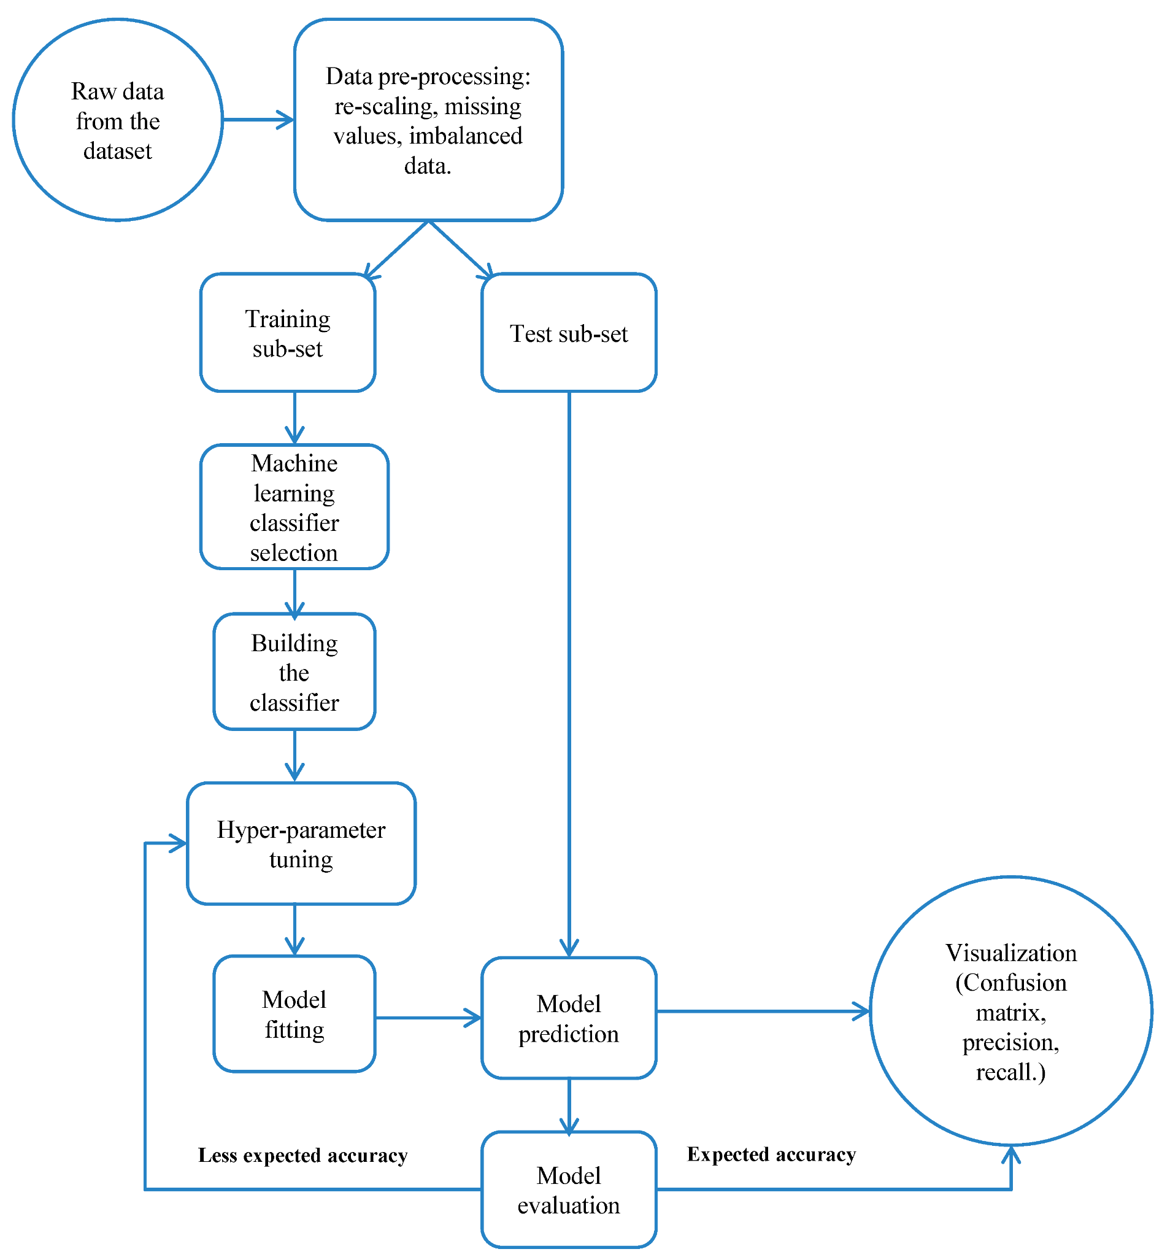
Model Fitting:
Model fitting is basically the implementation of testing and training data into different-different algorithms.
Here we use 5 algorithms for finding the accuracy of the result.
Logistic Regression
Decision Tree Classifier
Random Forest Classifier
K-nearest neighbors algorithm
Support Vector Machine

Slide 20


Logistic Regression:
Accuracy_Score: 0.9542151162790697
Precision: 0.9086746490120178
Recall: 0.9043478260869565
F1 Score: 0.9053604760305527
Confusion:
[[85 6 0 0]
[ 4 77 6 0]
[ 0 5 71 2]
[ 0 0 10 79]]
CV_Accuracy_Scores: [0.93464052, 0.92810458, 0.92358079]

Slide 21


Decision Tree Classifier:
Accuracy_Score: 0.8030523255813954
Precision: 0.7950707593034123
Recall: 0.7971014492753623
F1 Score: 0.7956841702897494
Confusion:
[[84 7 0 0]
[13 59 15 0]
[ 0 16 53 9]
[ 0 0 10 79]]
CV_Accuracy_Scores: [0.77559913 0.75599129 0.79039301]

Slide 22


Random Forest Classifier:
Accuracy_Score: 0.965843023255814
Precision: 0.8646868046812217
Recall: 0.8521739130434782
F1 Score: 0.8549822661078635
Confusion:
[[85 6 0 0]
[ 5 68 14 0]
[ 0 9 67 2]
[ 0 0 15 74]]
CV_Accuracy_Scores: [0.86056645 0.85185185 0.8580786 ]

Slide 23


K-Nearest Neighbors Algorithm:
Accuracy_Score: 1.0
Precision: 0.587613614475431
Recall: 0.5652173913043478
F1 Score: 0.5660178530845097
Confusion:
[[67 17 7 0]
[28 30 25 4]
[ 5 18 47 8]
[ 1 5 32 51]]
CV_Accuracy_Scores: [0.51198257 0.58169935 0.57641921]

Slide 24


Support Vector Machine Algorithm:
Accuracy_Score: 0.9542151162790697
Precision: 0.9192464811035428
Recall: 0.9159420289855073
F1 Score: 0.9166958942552748
Confusion:
[[88 3 0 0]
[ 3 79 5 0]
[ 0 6 70 2]
[ 0 0 10 79]]
CV_Accuracy_Scores: [0.93464052 0.92592593 0.93231441]

Slide 25


Visualize comparison between all algorithms:
First chart, show the comparison between accuracy score comes through cross-validation.
And Second chart, show the comparison between accuracy and F1 score between all the algorithms.
By these charts we get the idea that which algorithm have best accuracy.

Slide 26
Business Context:
The business objective for mobile price range prediction can vary depending on the specific context and goals of the business. Here are some possible business objectives for mobile price range prediction:
Pricing Strategy: The business may want to optimize its pricing strategy by accurately predicting the price range of mobile devices. This can help the business determine the appropriate pricing levels for different types of mobile devices, taking into consideration factors such as production costs, competition, and customer preferences.
Sales Forecasting: Accurate prediction of mobile price range can help the business in forecasting sales and revenue, as pricing is a key factor that affects customer purchasing decisions. By understanding the price range of mobile devices that are likely to sell well, the business can plan its inventory levels, production, and marketing efforts accordingly.
Market Segmentation: Mobile price range prediction can also aid in market segmentation, allowing the business to identify and target different customer segments based on their price preferences. For example, the business can develop different marketing strategies for budget-conscious customers who are interested in lower-priced mobile devices versus premium customers who are willing to pay a premium for high-end mobile devices.

Slide 27
Some more point related to Business Context:
Competitive Analysis: Accurate prediction of mobile price range can help the business in conducting competitive analysis by comparing its pricing strategy with that of its competitors. This can provide insights into how the business is positioned in the market in terms of pricing, and whether adjustments need to be made to gain a competitive edge.
Customer Relationship Management: Mobile price range prediction can also be used to tailor pricing and promotional offers to individual customers, based on their predicted price range preferences. This can help improve customer satisfaction, loyalty, and retention, as customers are more likely to make purchases when pricing aligns with their expectations and budget.

Slide 28
Conclusion:
In conclusion, the mobile price range prediction problem is a typical machine learning classification task where the goal is to predict the price range of mobile devices based on certain features. In this project, various machine learning classification models were trained and evaluated using a labeled dataset of mobile device features and corresponding price ranges.
After analyzing the data, conducting feature engineering, and splitting the dataset into training and testing sets, multiple classification models such as Logistic Regression, Decision Tree, Random Forest, K-Nearest Neighbors (KNN), and Support Vector Machine (SVM) were trained and evaluated. Performance evaluation metrics such as accuracy, precision, recall, and F1-score were used to assess the performance of the models.

Slide 29
Some more points:
The mobile price range prediction project involved the development and evaluation of machine learning classification models using a labeled dataset of mobile device features. The project highlighted the importance of feature engineering, hyperparameter tuning, and model evaluation in achieving good performance. The results of this project can be utilized by businesses, mobile device manufacturers, and retailers to predict and optimize mobile prices, offer competitive pricing, and make informed business decisions. Further research and experimentation with different models, feature engineering techniques, and hyperparameter tuning approaches could be explored to enhance the predictive accuracy of the models and provide more valuable insights for the mobile device industry.

Slide 30


